Slide 1
Geo-localization of Low-altitude Overhead Image Using Multi-layer Shape Matching
Yuhang Li

Slide 2
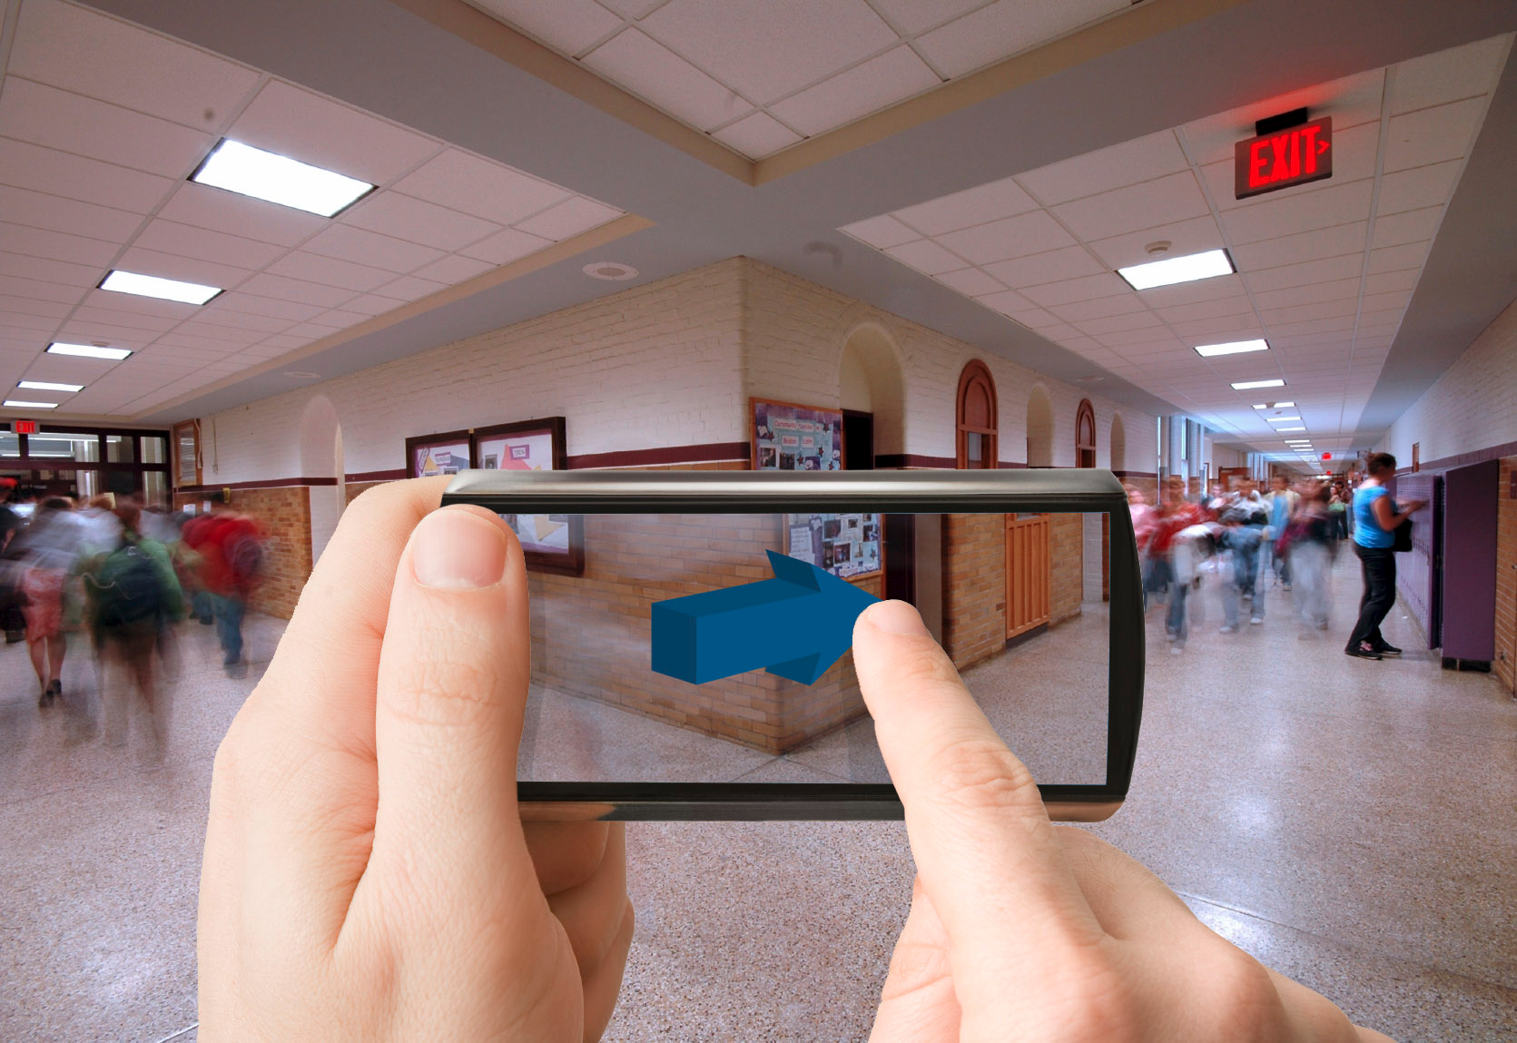
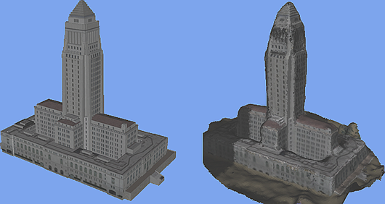
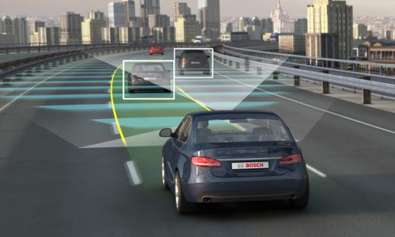
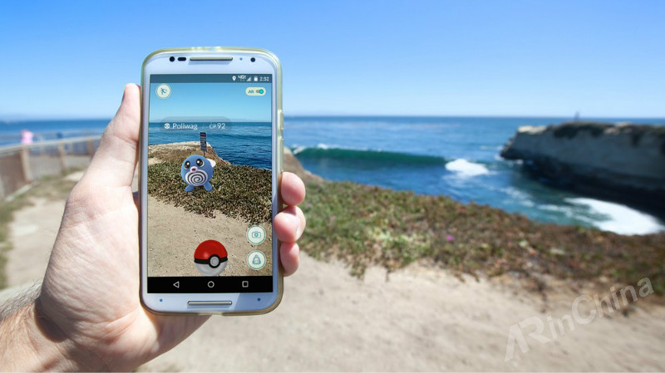
Vision-Based Geo-Localization
Navigation
Unmanned driving
Augmented reality (AR)
3D reconstruction

Slide 3
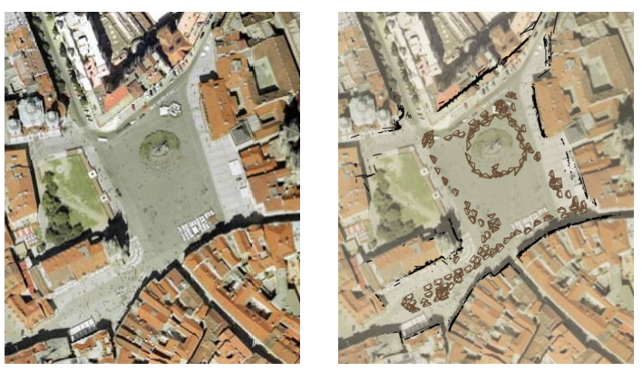
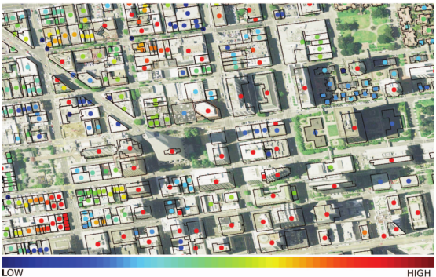
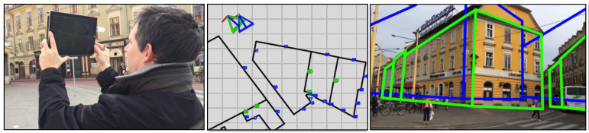
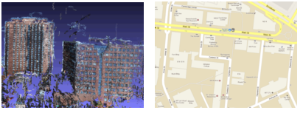
Related work
Satellite images and phone images (Kaminsky, et al, 2009)
Point clouds and Google maps (Ni, et al, 2013)
Satellite images and 3D building models (Zhang, et al, 2014)
Phone images and 2.5D maps (Arth, et al, 2015)
(Kaminsky, et al, 2009)
(Zhang, et al, 2014)
(Arth, et al, 2015)
(Ni, et al, 2013)

Slide 4
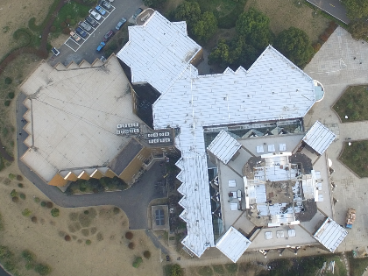
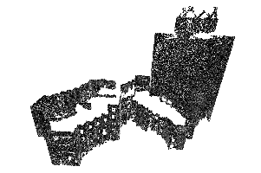
Problem statement
Input
Overhead images captured by a quadrotor in a low altitude.
Building point clouds scanned by a ground laser device.
Output
6DoF (3D for orientation and 3D for translation) camera pose of input image with respect to global point cloud coordinate system.

Slide 5
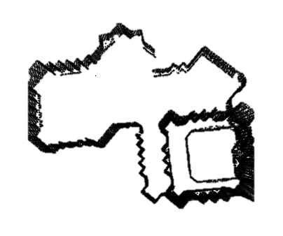
Observation
Vertical facades of a point cloud correspond to lines of building roofs in the overhead image.
Matching the edge map of the overhead image with respect to building facades’ outline.

Slide 6
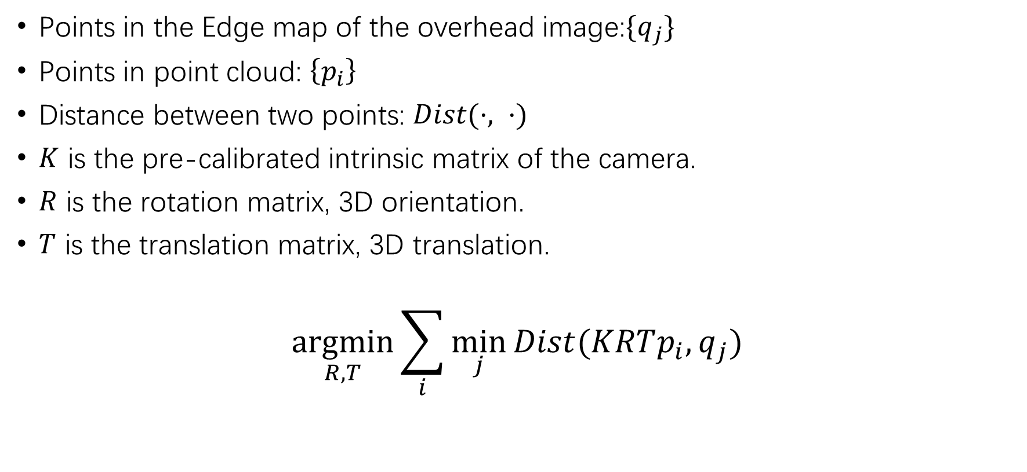
Optimization
Points in the Edge map of the overhead image:$\{q_{j}\}$
Points in point cloud: $\left\{p_{i}\right\}$
Distance between two points: $Dist(·, ·)$
$K$ is the pre-calibrated intrinsic matrix of the camera.
$R$ is the rotation matrix, 3D orientation.
$T$ is the translation matrix, 3D translation.
$$\underset{R,T}{argmin}{\sum_{i}{\min_{j}{Dist(KRTp_{i},q_{j})}}}$$

Slide 7
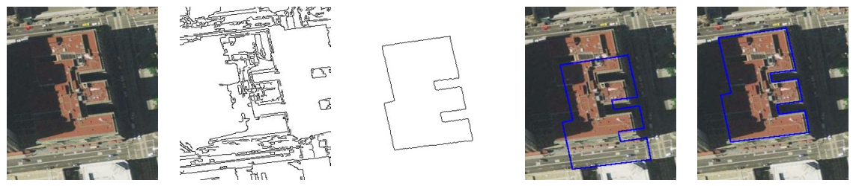
2D shape matching
High complexity
Initialization sensitivity
2D shape matching between edge map of the overhead image and building facades’ 2D outline.
Matching edge map with building facades’ outline. (Zhang, et al, 2014)

Slide 8
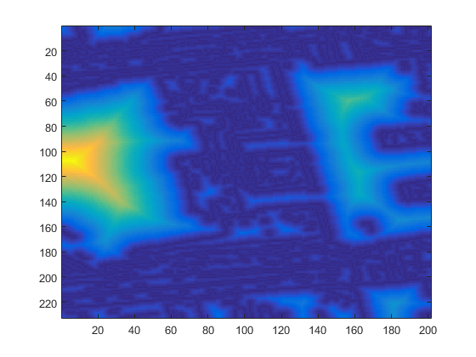
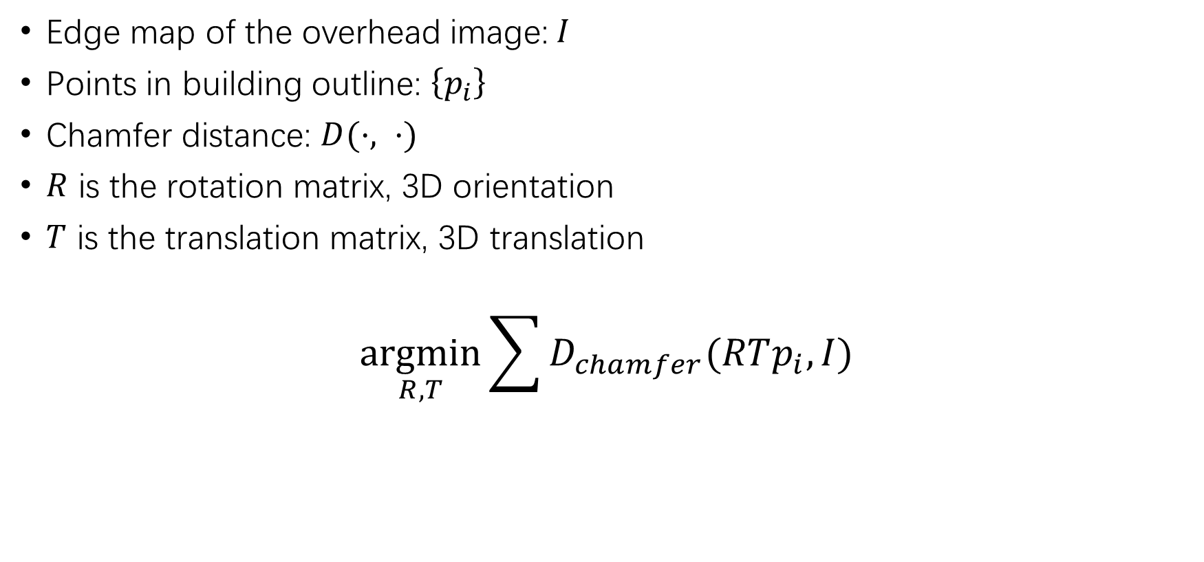
2D Shape matching
Edge map of the overhead image:$I$
Points in building outline: $\left\{p_{i}\right\}$
Chamfer distance: $D(·, ·)$
$R$ is the rotation matrix, 3D orientation
$T$ is the translation matrix, 3D translation
$$\underset{R,T}{argmin}{\sum{D_{chamfer}(RTp_{i},I)}}$$
Chamfer distance

Slide 9
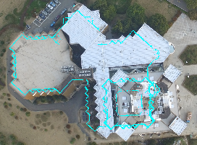
Challenges with low-altitude overhead image
Satellite image:
Identical scale assumption.
One-layer outline.
Low-altitude image:
More critical perspective effect.
Building layers in different heights correspond to different scales in the overhead image.

Slide 10
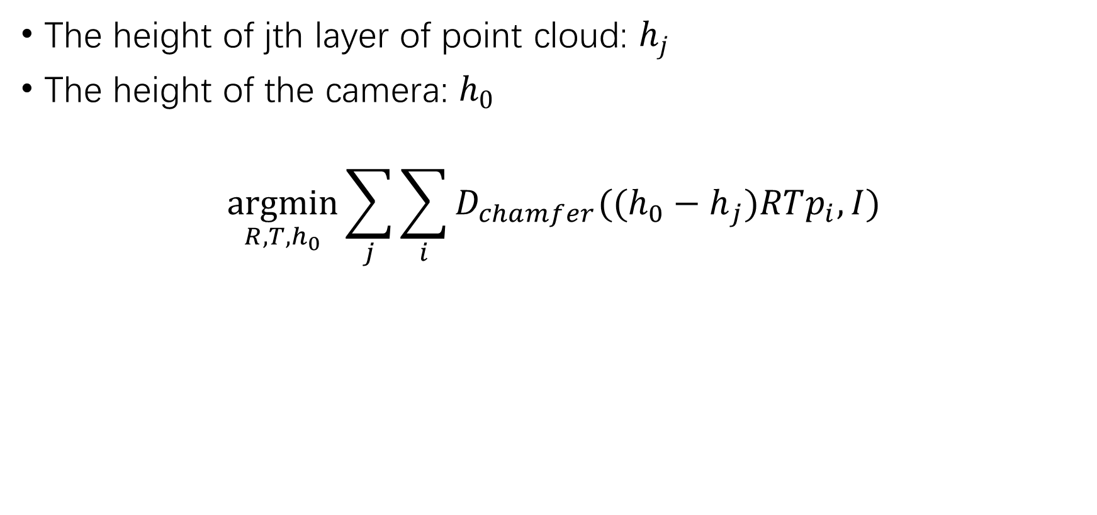
Multi-layer shape matching
The height of jth layer of point cloud: $h_{j}$
The height of the camera: $h_{0}$
$$\underset{R, T,h_{0}}{argmin}{\sum_{j}{\sum_{i}{D_{chamfer}(({h_{0}−h}_{j})RTp_{i},I)}}}$$

Slide 11
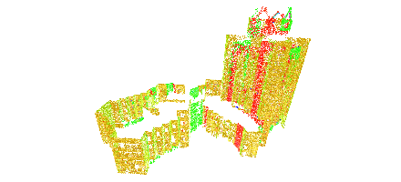
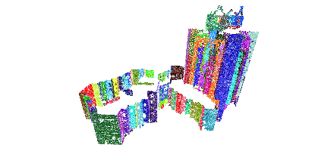
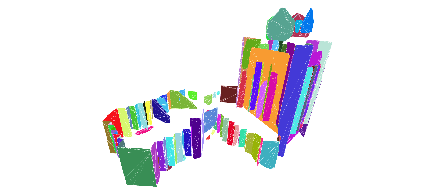
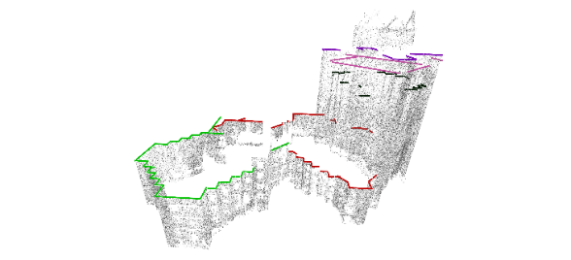
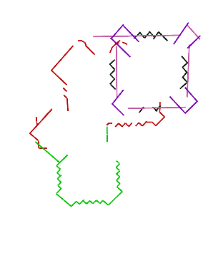
Layers of point cloud
Normal estimation
Over-segmentation
Planar fitting
Multi-layer projection
Input point cloud
Normal estimation
Over-segmentation
Planar fitting
Multi-layer projection
Multi-layer 3D line presentation
Point cloud processing

Slide 12

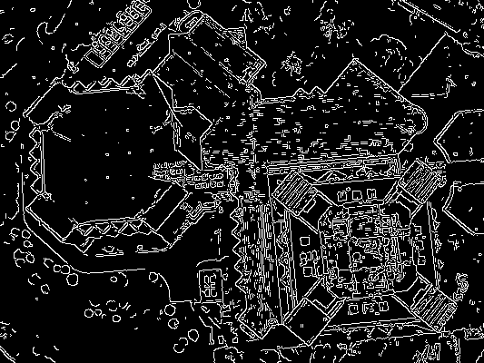
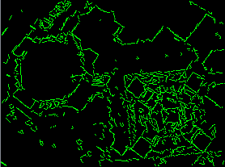
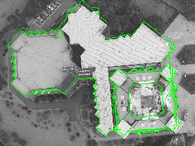
Multi-layer shape matching
Input image
Edge image
2D line presentation
Image processing
Multi-layer shape matching
Result
Input point cloud
Normal estimation
Over-segmentation
Planar fitting
Multi-layer projection
Multi-layer 3D line presentation
Point cloud processing

Slide 13
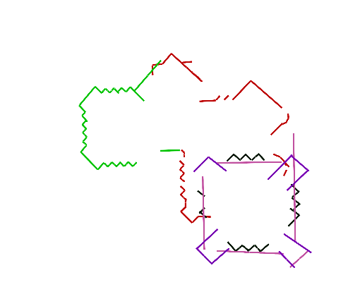
Pipeline
Image processing
Edge image
2D line presentation
Point cloud processing
Normal estimation
Over-segmentation
Planar fitting
Multi-layer projection
Multi-layer 3D line presentation
Multi-layer geo-localization
Multi-layer shape matching
Geo-localization
Input image
Edge image
2D line presentation
Image processing
Input point cloud
Normal estimation
Over-segmentation
Planar fitting
Multi-layer projection
Multi-layer 3D line presentation
Point cloud processing
Rotated 3D line presentation
Alignment result
Multi-layer geo-localization

Slide 14
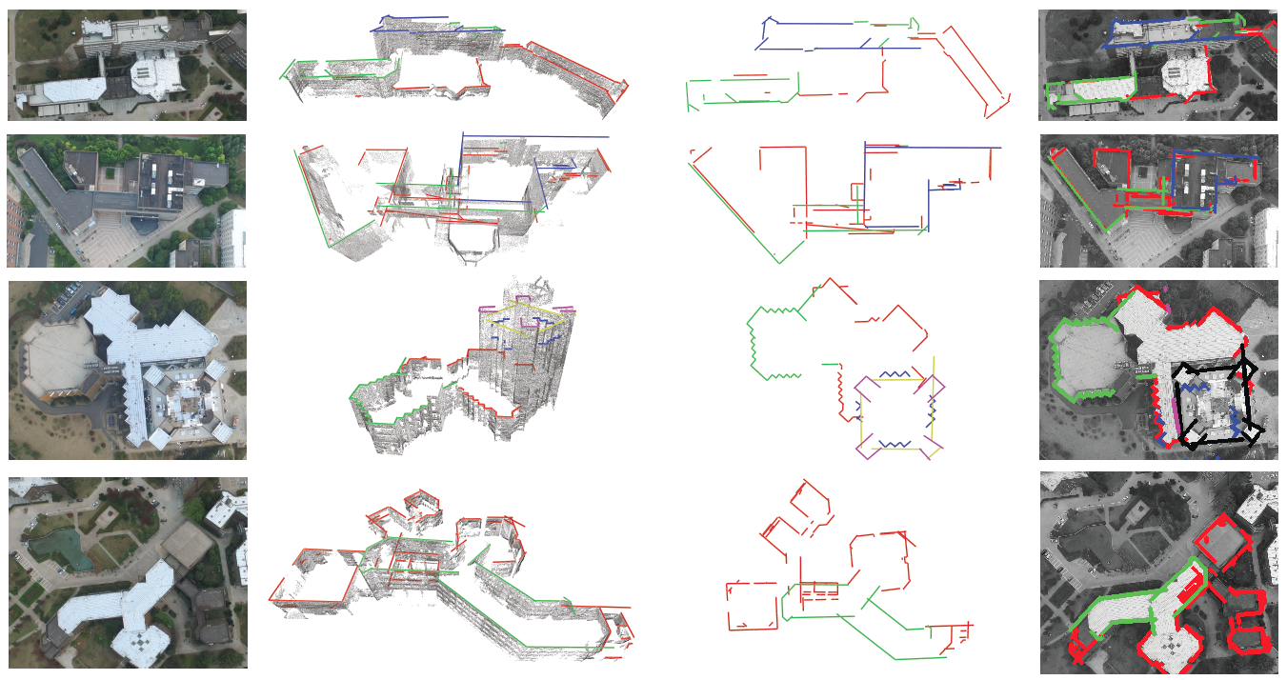
Results
We test our localization results by projecting layers of point clouds back to the overhead image.

